Slide 1

Equity Trading: AI Companies Recommendation

Slide 2
Agenda
Introduction
Data Collection
Data Analysis
Comparison and Insights
Recommendations
Visual Aids
Conclusion

Slide 3

Executive Summary

Slide 4
Executive Summary
Our Customer is interested in investing in the AI Market and requested assistance on which stocks to invest in
In this project we have selected 19 AI Stocks and have leveraged Data Science to assess best AI Stocks to invest
We collected excellent quality stock data using Tradestation API’s, and performed clean-up and analysis using several techniques such as:
Price pattern,
Technical Indicators, and
Prediction Algo leveraging Prophet
Top 3 AI Stocks to invest are recommended and justification are provided in the Conclusion section of this presentation

Slide 5
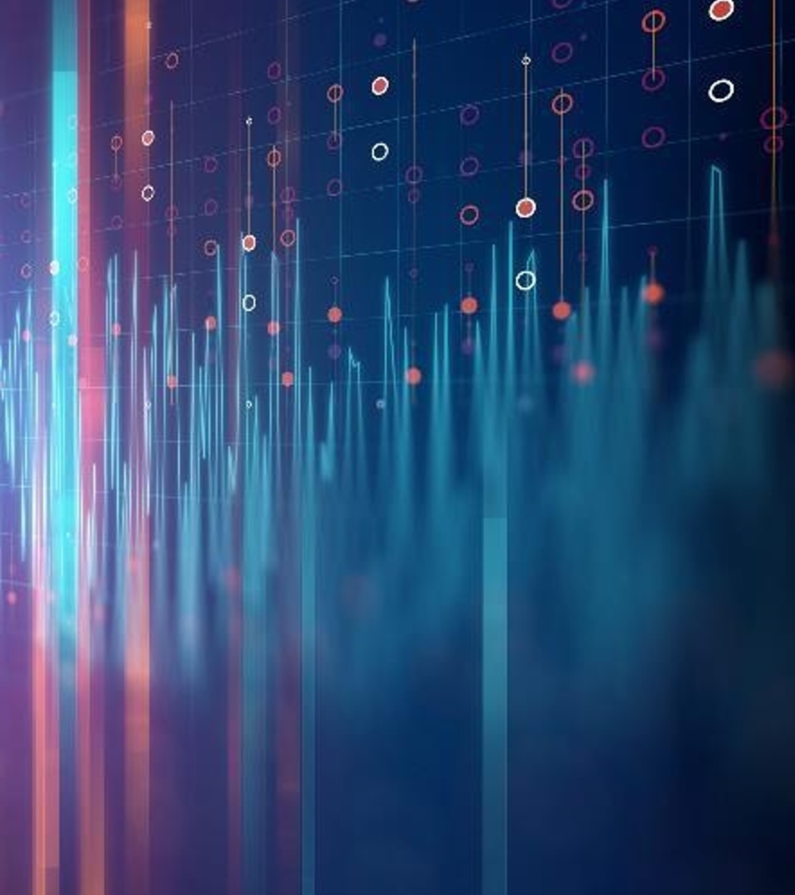
Data Process
Data Collection, leveraging Tradestation WEB API’s
Cleanup, eliminating noise
Exploration & Insights, Technical Analysis with Prediction

Slide 6
Data Collection Process
Tradestation is one of the leading Trading Platform provider, enabling easy access to quality market data, while free of charge
The Process to collect the data:
Generated an Access Token, with the allowed Scope defined
Defined the base url
Defined the data length for historical purposes
Using list comprehension, we created a List composed of the json file for each AI Stock being evaluated
All collected data were stored locally, avoiding having to call the API’s every time.
# make it with dictionary ai_stocks_data = [requests.get(f"{base_url}{stock}{data_length}", headers=headers).json() for stock in ai_stocks_list]
market_index_list_data = [requests.get(f"{base_url}{stock}{data_length}", headers=headers).json() for stock in market_index_list]
# save the data to a json file with open('ai_stocks_data.json', 'w') as f:
json.dump(ai_stocks_data, f)
#with open('market_index_list_data.json', 'w') as f:
json.dump(market_index_list_data, f)

Slide 7
Data Cleanup Process
Created dictionary of Dataframe for each stock symbol
The Dataframe was filtered, resulting in Date, OHCLV bar information structure
Date was converted to Datetime and set as index and rest of the data was converted to float
Data is now ready for analysis

Slide 8
Exploration & Insights Process
Technical Analysis & Trend Analysis
Correlation Analysis
With Market Benchmarks (SPY and QQQ)
Between Stocks
Prediction Algo leveraging Prophet
52 weeks and 12 weeks Performance Analysis

Slide 9

Visuals

Slide 10
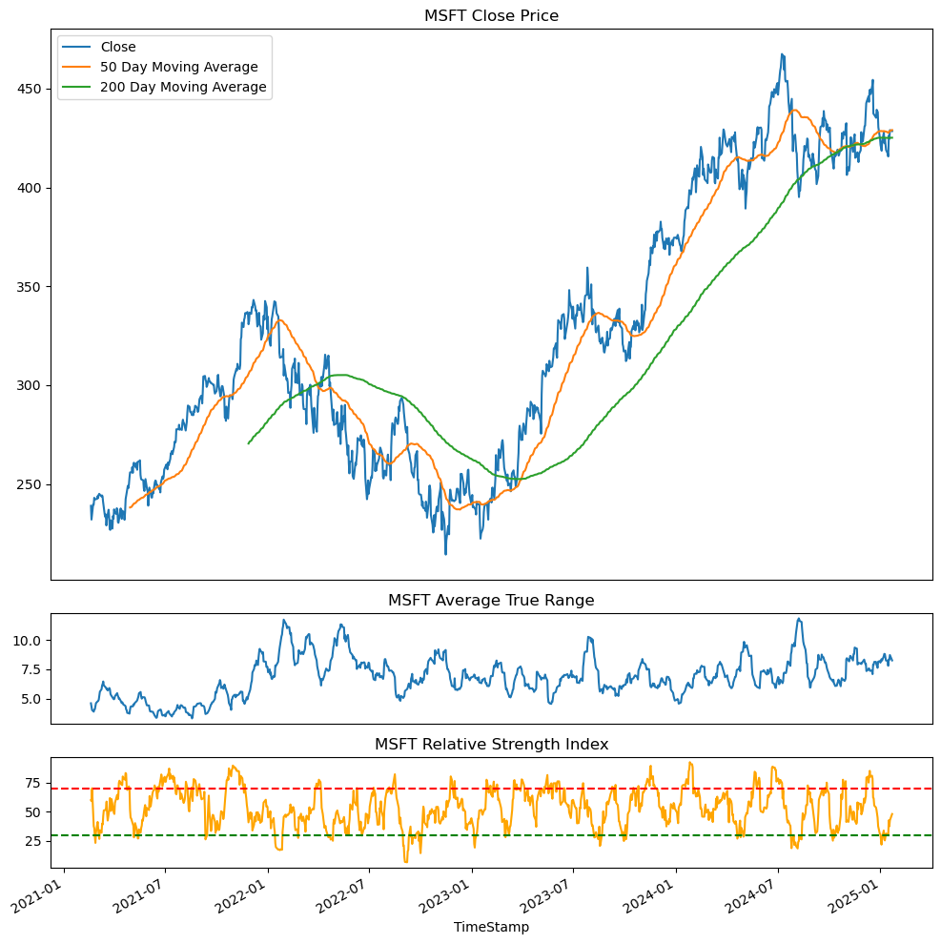
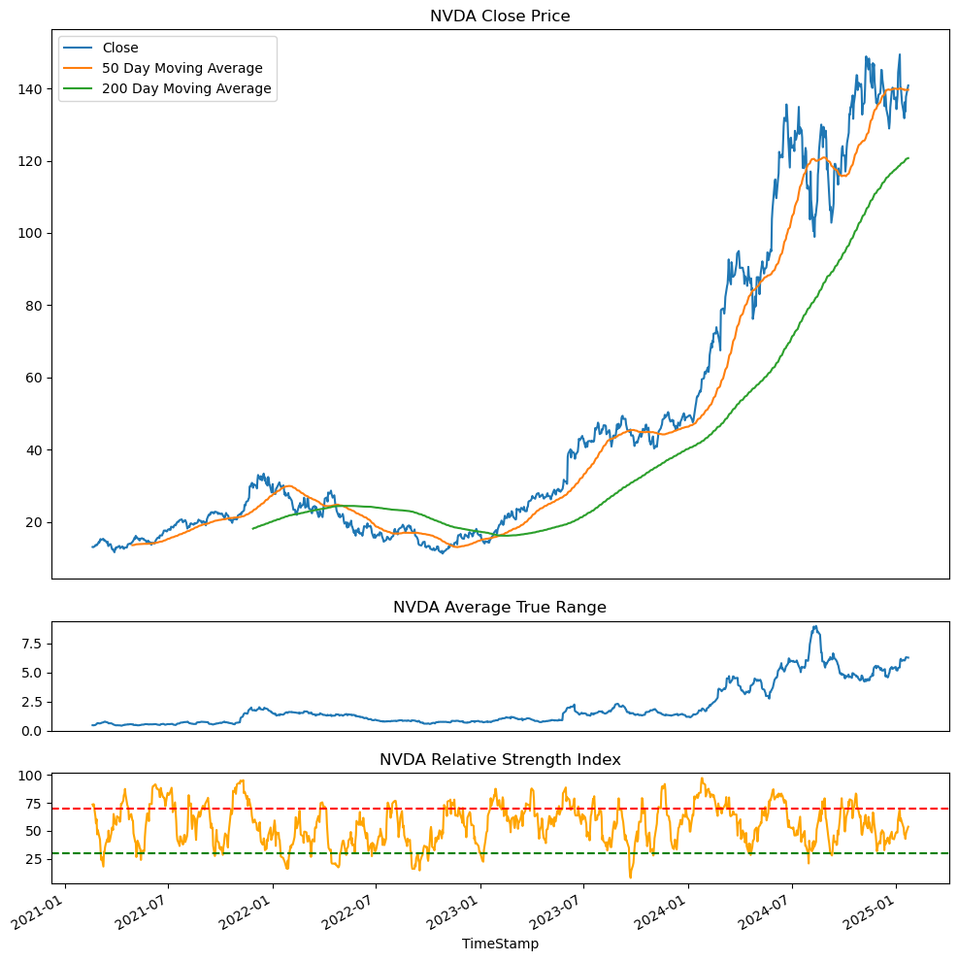
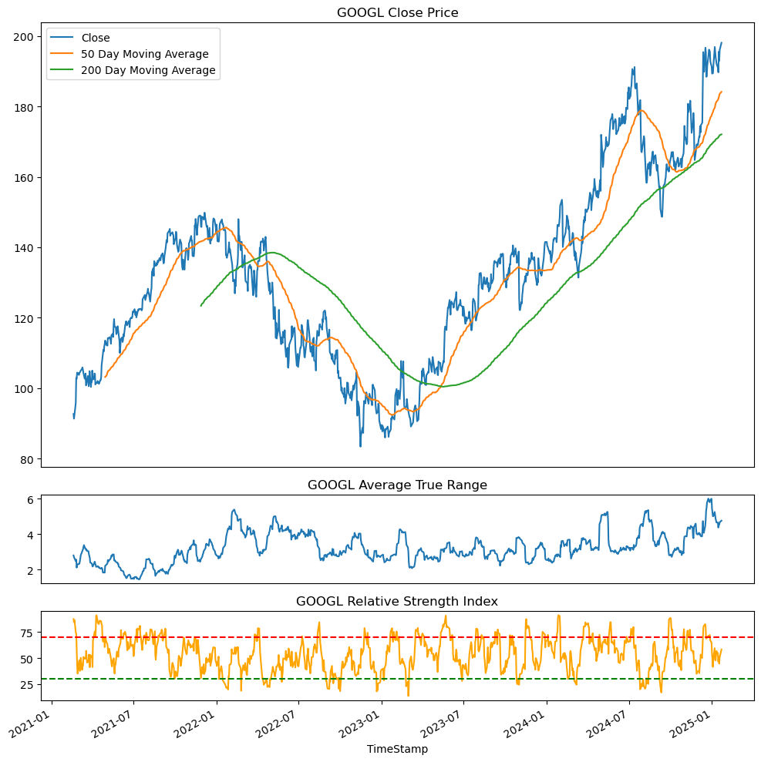
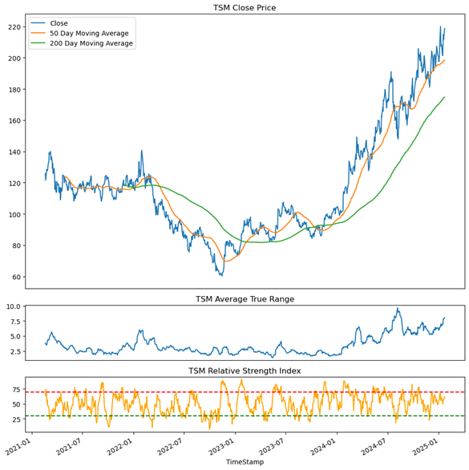
1. Technical Analysis (1/5)

Slide 11
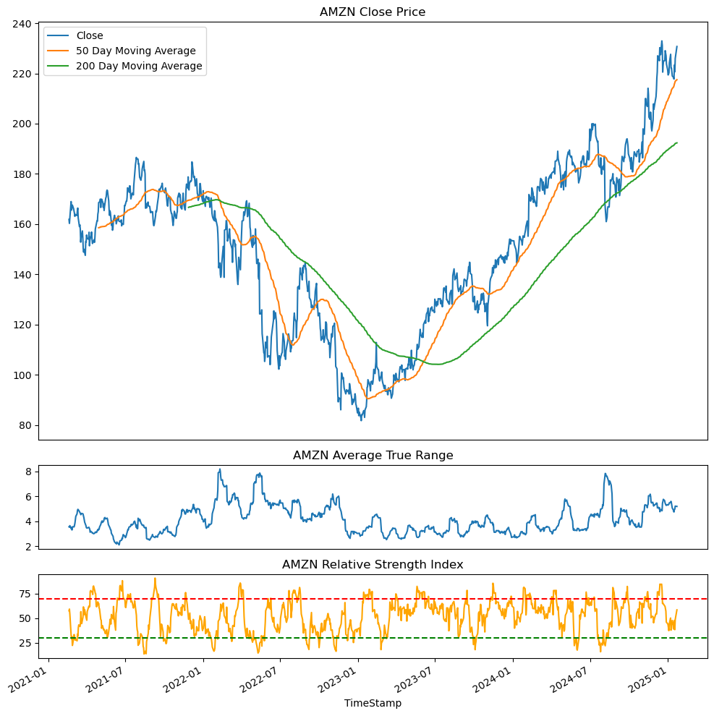
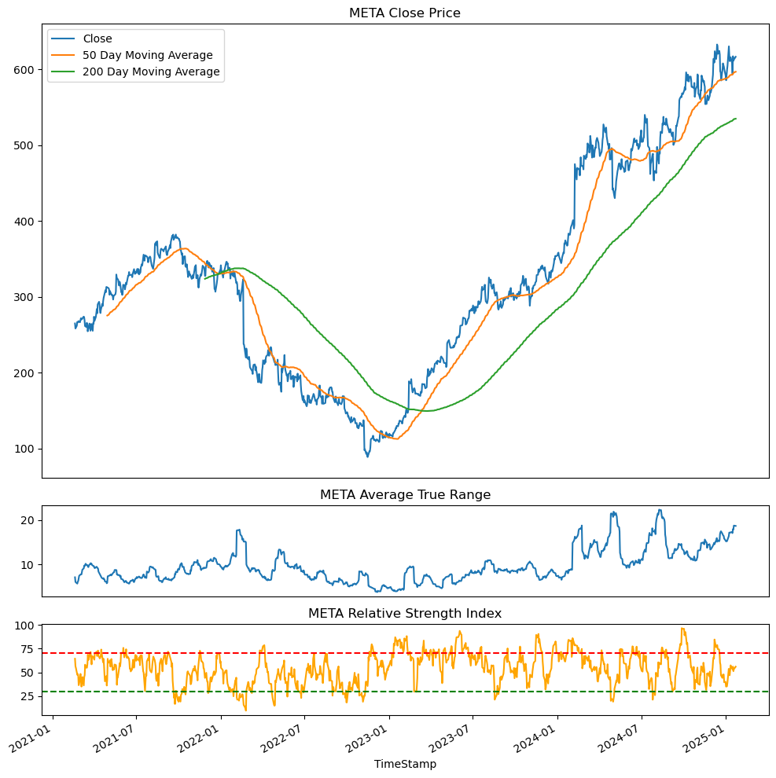
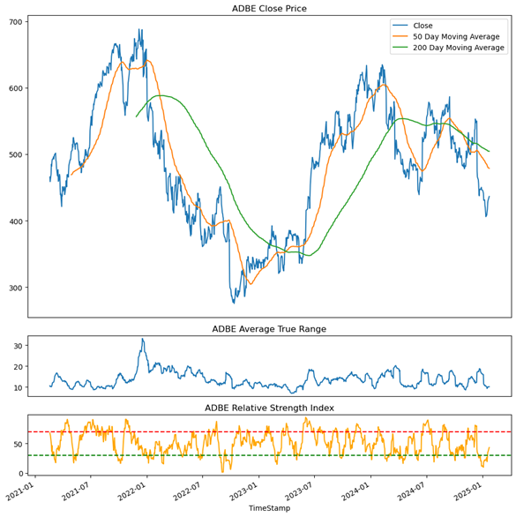
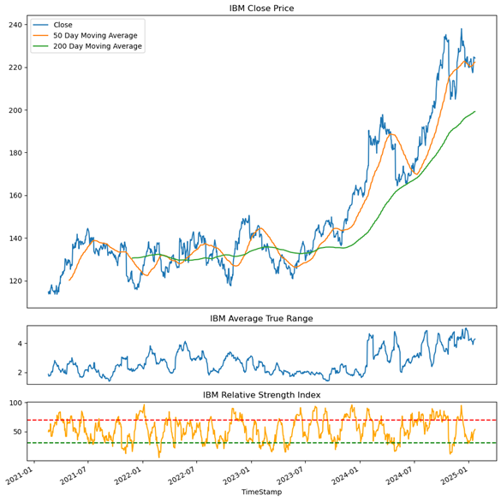
1. Technical Analysis (2/5)

Slide 12
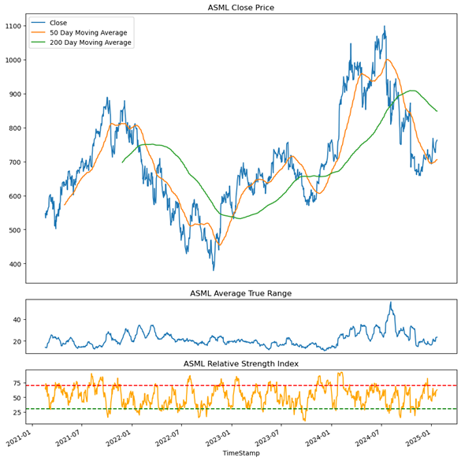
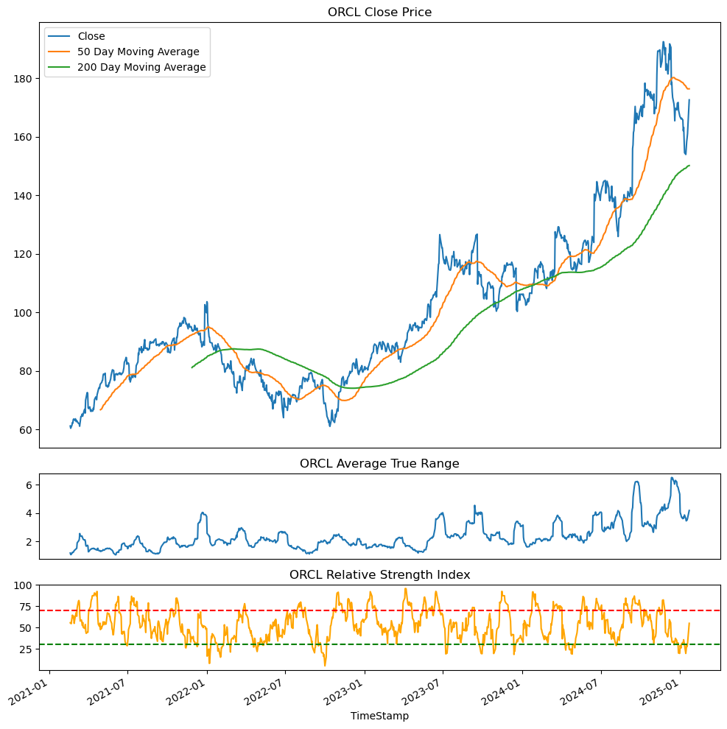
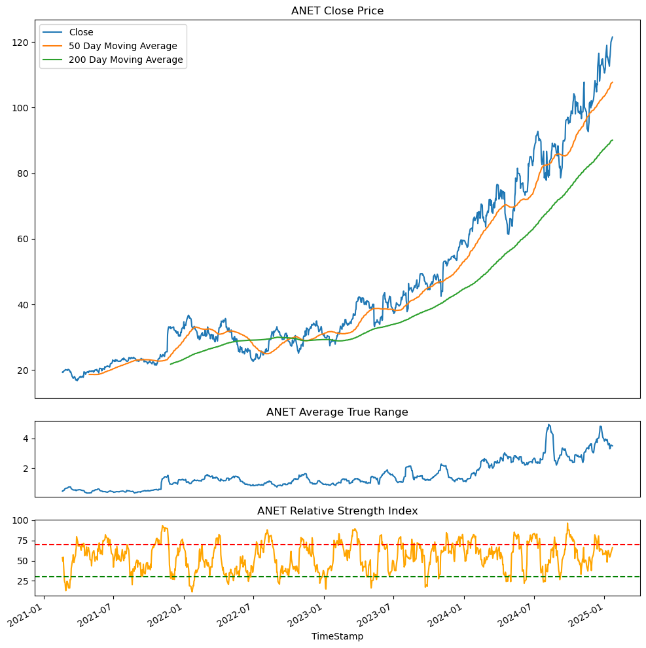
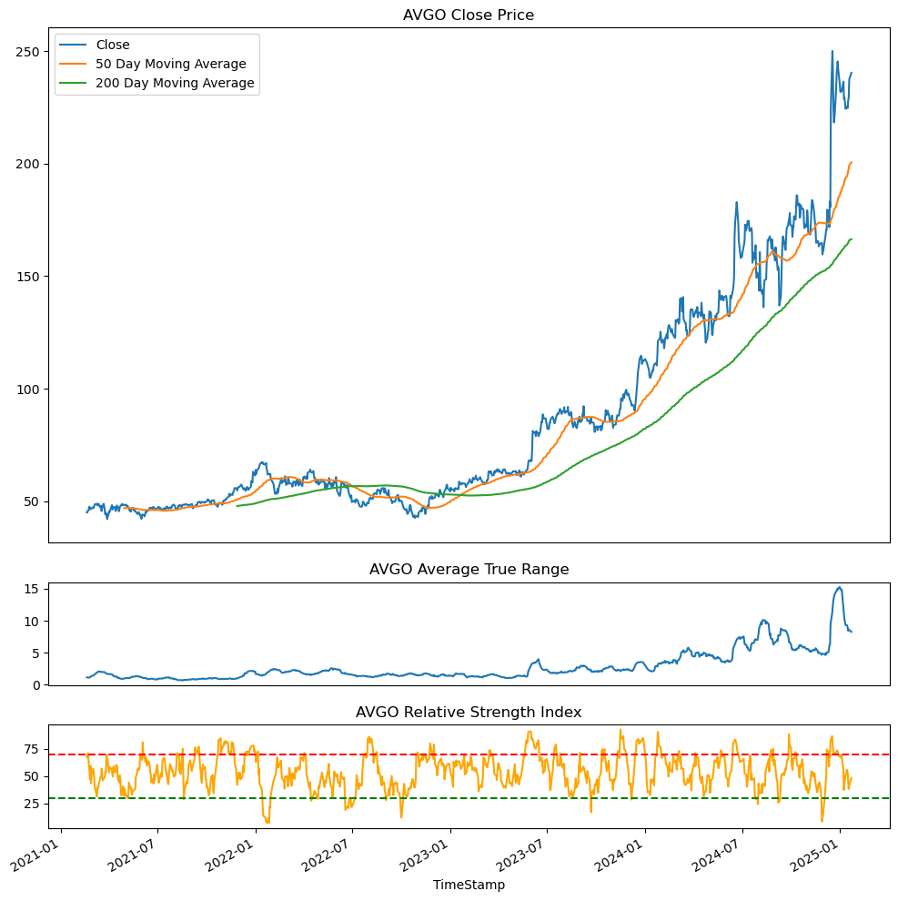
1. Technical Analysis (3/5)

Slide 13
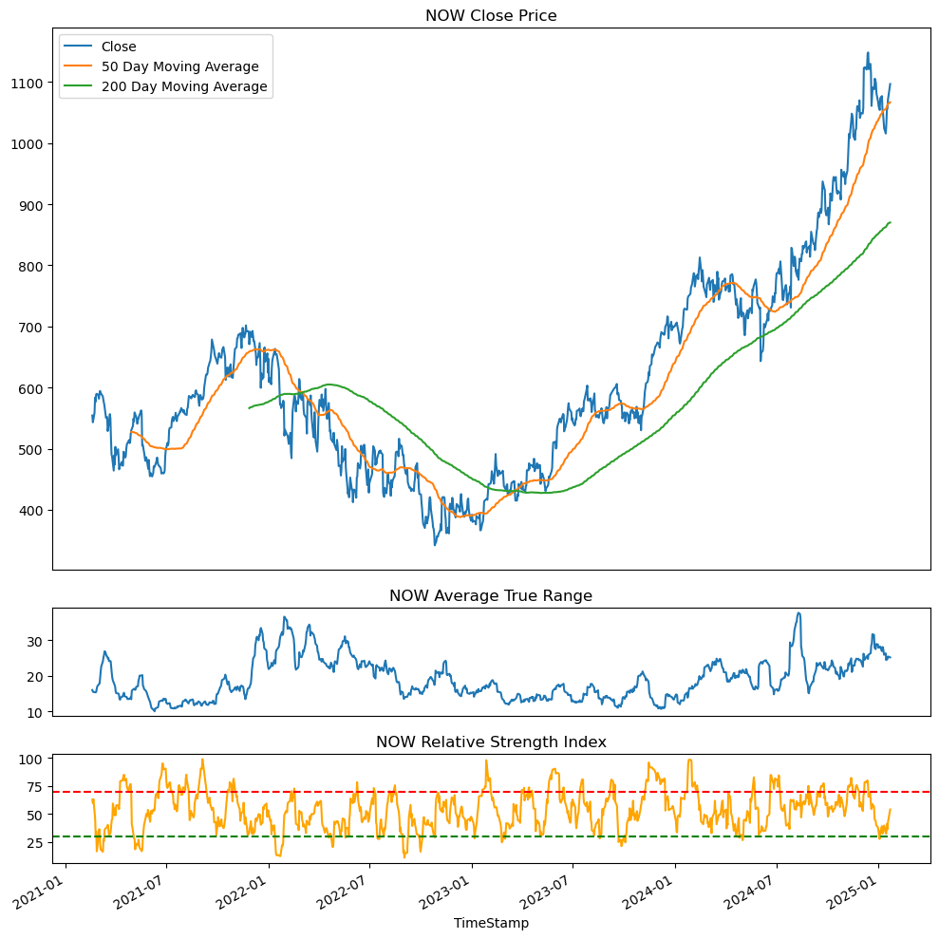
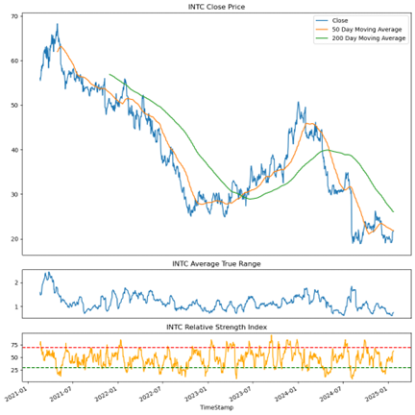
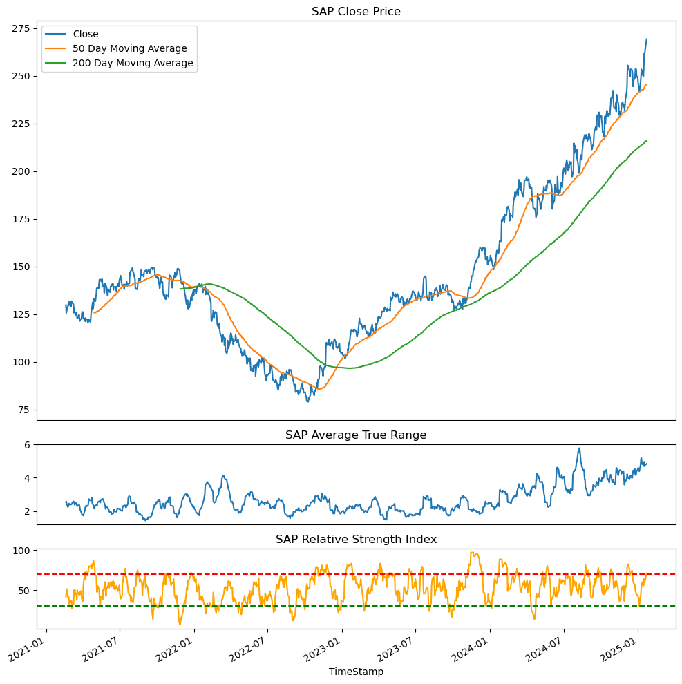
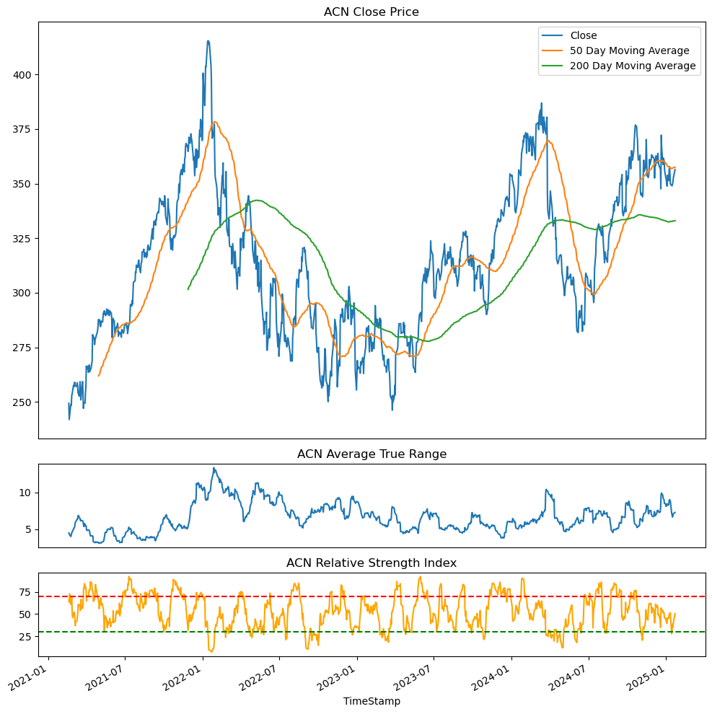
1. Technical Analysis (4/5)

Slide 14
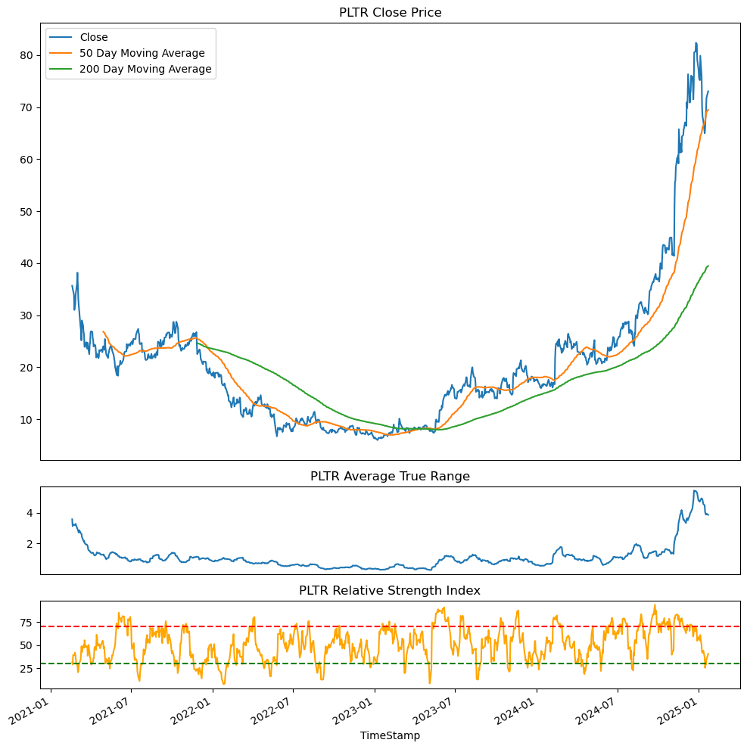
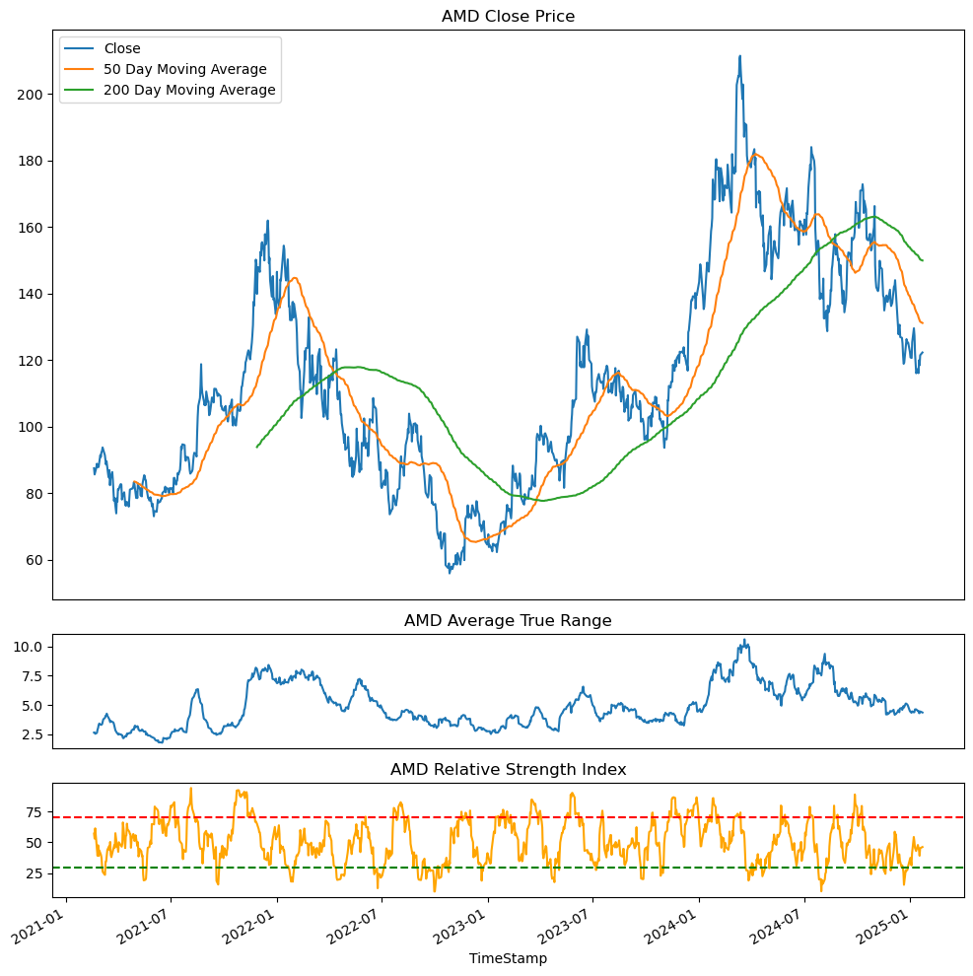
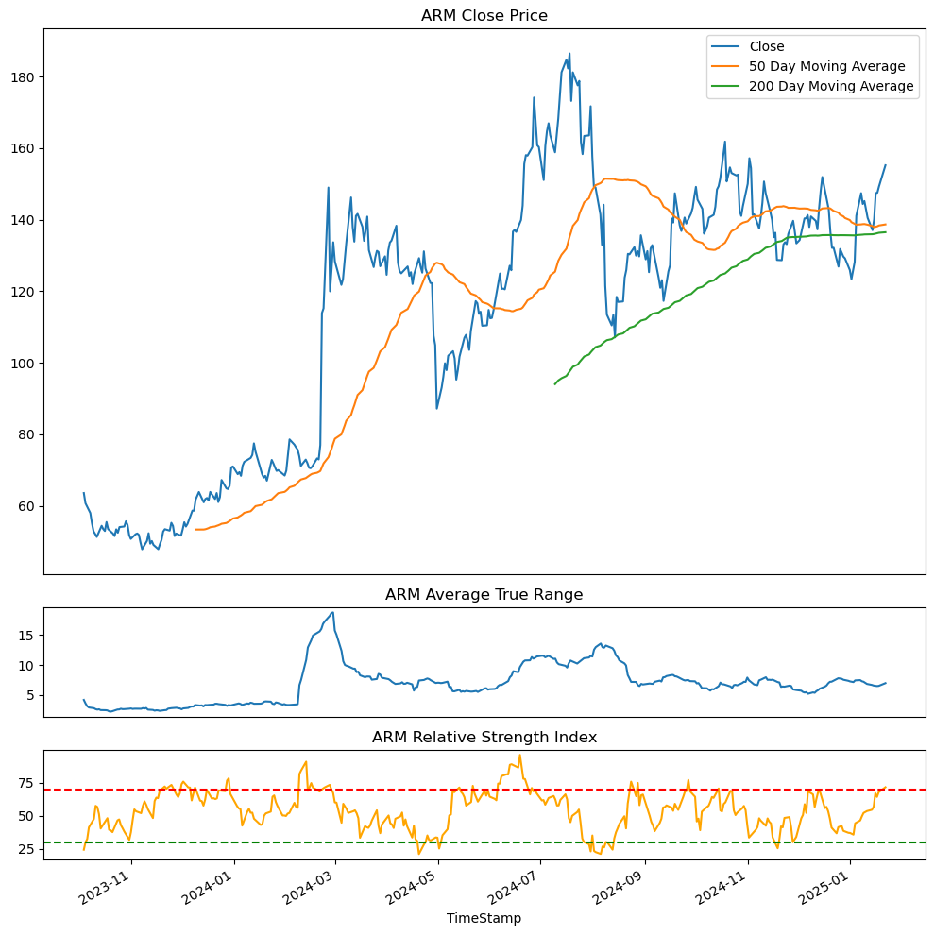
1. Technical Analysis (5/5)

Slide 15
2. Market Correlation
 | Correlation with SPY | Correlation with QQQ
ACN | 0.79 | 0.65
ADBE | -0.01 | -0.05
AMD | -0.45 | -0.40
AMZN | 0.74 | 0.82
ANET | 0.94 | 0.94
ARM | 0.51 | 0.61
ASML | -0.69 | -0.53
AVGO | 0.79 | 0.86
GOOGL | 0.48 | 0.66
IBM | 0.85 | 0.73
INTC | -0.66 | -0.55
META | 0.89 | 0.85
MSFT | 0.35 | 0.53
NOW | 0.91 | 0.84
NVDA | 0.91 | 0.92
ORCL | 0.94 | 0.85
PLTR | 0.88 | 0.86
SAP | 0.93 | 0.87
TSM | 0.93 | 0.95

Slide 16
2. Stocks Correlation
 | NVDA | MSFT | GOOGL | AMZN | META | TSM | ASML | ADBE | IBM | ANET | AVGO | ORCL | SAP | ACN | NOW | AMD | PLTR | ARM | INTC
NVDA | 1.00 | 0.92 | 0.85 | 0.67 | 0.88 | 0.87 | 0.62 | 0.24 | 0.92 | 0.97 | 0.97 | 0.94 | 0.93 | 0.49 | 0.89 | 0.74 | 0.73 | 0.90 | -0.54
MSFT | 0.92 | 1.00 | 0.90 | 0.69 | 0.88 | 0.76 | 0.77 | 0.47 | 0.82 | 0.91 | 0.91 | 0.88 | 0.88 | 0.66 | 0.88 | 0.90 | 0.60 | 0.90 | -0.39
GOOGL | 0.85 | 0.90 | 1.00 | 0.85 | 0.89 | 0.85 | 0.72 | 0.55 | 0.73 | 0.80 | 0.83 | 0.80 | 0.85 | 0.69 | 0.90 | 0.80 | 0.72 | 0.78 | -0.21
AMZN | 0.67 | 0.69 | 0.85 | 1.00 | 0.87 | 0.87 | 0.63 | 0.64 | 0.61 | 0.59 | 0.63 | 0.61 | 0.79 | 0.62 | 0.84 | 0.66 | 0.81 | 0.83 | 0.15
META | 0.88 | 0.88 | 0.89 | 0.87 | 1.00 | 0.91 | 0.74 | 0.57 | 0.83 | 0.83 | 0.85 | 0.85 | 0.96 | 0.62 | 0.93 | 0.79 | 0.82 | 0.88 | -0.17
TSM | 0.87 | 0.76 | 0.85 | 0.87 | 0.91 | 1.00 | 0.63 | 0.39 | 0.79 | 0.79 | 0.83 | 0.79 | 0.92 | 0.52 | 0.90 | 0.67 | 0.86 | 0.89 | -0.19
ASML | 0.62 | 0.77 | 0.72 | 0.63 | 0.74 | 0.63 | 1.00 | 0.60 | 0.50 | 0.55 | 0.58 | 0.55 | 0.69 | 0.56 | 0.62 | 0.84 | 0.36 | 0.60 | -0.02
ADBE | 0.24 | 0.47 | 0.55 | 0.64 | 0.57 | 0.39 | 0.60 | 1.00 | 0.19 | 0.18 | 0.21 | 0.31 | 0.44 | 0.66 | 0.51 | 0.57 | 0.36 | -0.42 | 0.45
IBM | 0.92 | 0.82 | 0.73 | 0.61 | 0.83 | 0.79 | 0.50 | 0.19 | 1.00 | 0.94 | 0.93 | 0.89 | 0.89 | 0.52 | 0.86 | 0.65 | 0.73 | 0.73 | -0.52
ANET | 0.97 | 0.91 | 0.80 | 0.59 | 0.83 | 0.79 | 0.55 | 0.18 | 0.94 | 1.00 | 0.99 | 0.93 | 0.90 | 0.50 | 0.87 | 0.71 | 0.70 | 0.82 | -0.62
AVGO | 0.97 | 0.91 | 0.83 | 0.63 | 0.85 | 0.83 | 0.58 | 0.21 | 0.93 | 0.99 | 1.00 | 0.92 | 0.91 | 0.49 | 0.89 | 0.71 | 0.73 | 0.80 | -0.56
ORCL | 0.94 | 0.88 | 0.80 | 0.61 | 0.85 | 0.79 | 0.55 | 0.31 | 0.89 | 0.93 | 0.92 | 1.00 | 0.91 | 0.55 | 0.88 | 0.67 | 0.74 | 0.70 | -0.56
SAP | 0.93 | 0.88 | 0.85 | 0.79 | 0.96 | 0.92 | 0.69 | 0.44 | 0.89 | 0.90 | 0.91 | 0.91 | 1.00 | 0.57 | 0.94 | 0.73 | 0.84 | 0.83 | -0.33
ACN | 0.49 | 0.66 | 0.69 | 0.62 | 0.62 | 0.52 | 0.56 | 0.66 | 0.52 | 0.50 | 0.49 | 0.55 | 0.57 | 1.00 | 0.71 | 0.74 | 0.47 | 0.21 | 0.03
NOW | 0.89 | 0.88 | 0.90 | 0.84 | 0.93 | 0.90 | 0.62 | 0.51 | 0.86 | 0.87 | 0.89 | 0.88 | 0.94 | 0.71 | 1.00 | 0.76 | 0.87 | 0.66 | -0.27
AMD | 0.74 | 0.90 | 0.80 | 0.66 | 0.79 | 0.67 | 0.84 | 0.57 | 0.65 | 0.71 | 0.71 | 0.67 | 0.73 | 0.74 | 0.76 | 1.00 | 0.42 | 0.56 | -0.13
PLTR | 0.73 | 0.60 | 0.72 | 0.81 | 0.82 | 0.86 | 0.36 | 0.36 | 0.73 | 0.70 | 0.73 | 0.74 | 0.84 | 0.47 | 0.87 | 0.42 | 1.00 | 0.54 | -0.16
ARM | 0.90 | 0.90 | 0.78 | 0.83 | 0.88 | 0.89 | 0.60 | -0.42 | 0.73 | 0.82 | 0.80 | 0.70 | 0.83 | 0.21 | 0.66 | 0.56 | 0.54 | 1.00 | -0.55
INTC | -0.54 | -0.39 | -0.21 | 0.15 | -0.17 | -0.19 | -0.02 | 0.45 | -0.52 | -0.62 | -0.56 | -0.56 | -0.33 | 0.03 | -0.27 | -0.13 | -0.16 | -0.55 | 1.00

Slide 17
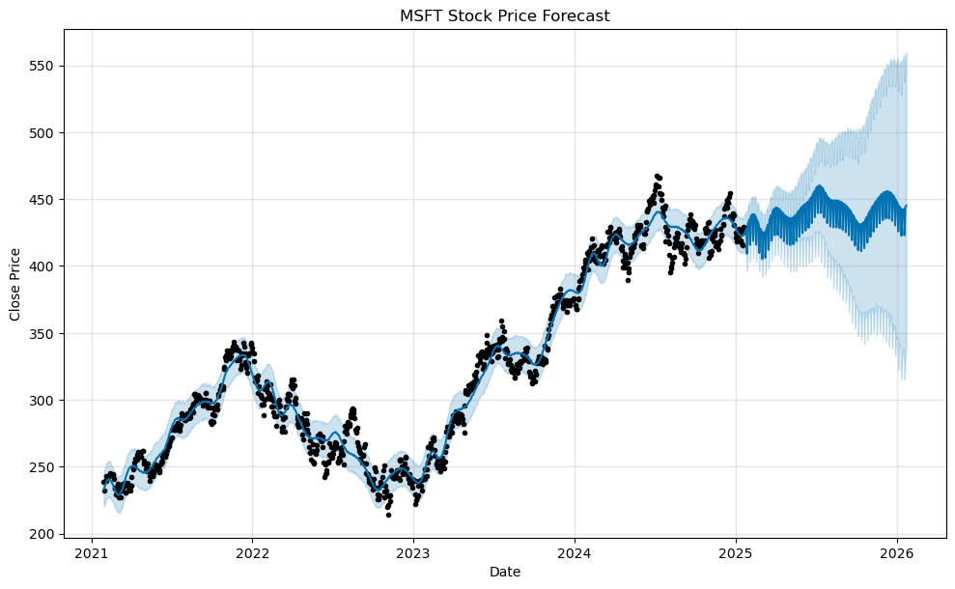
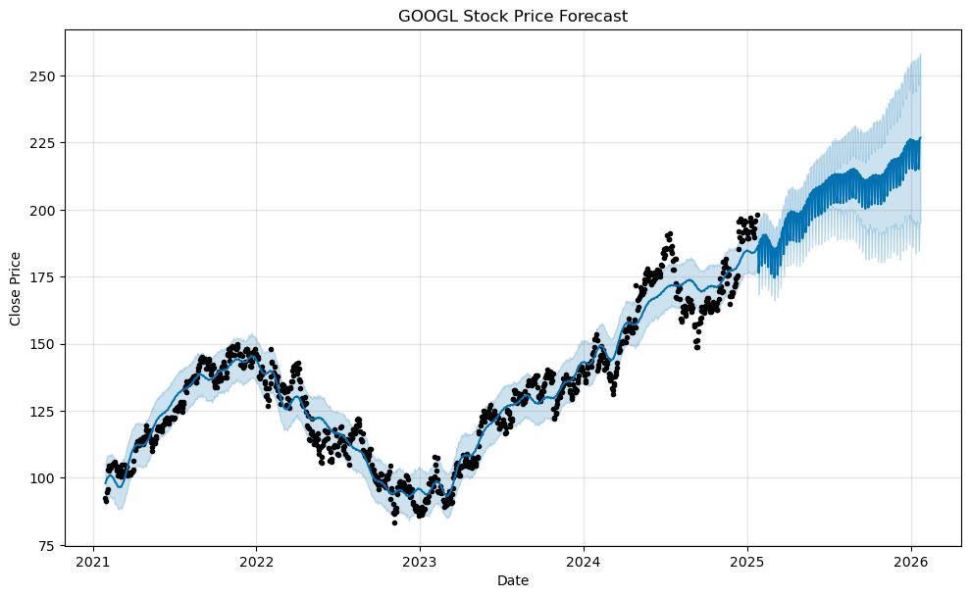
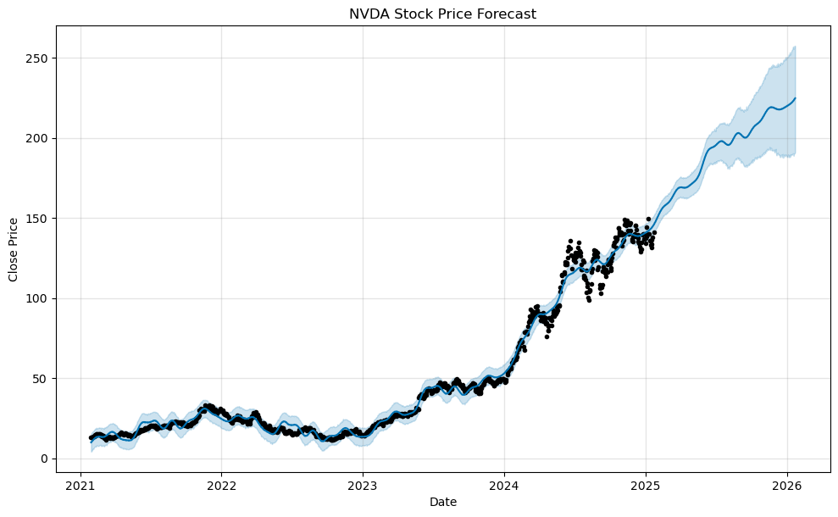
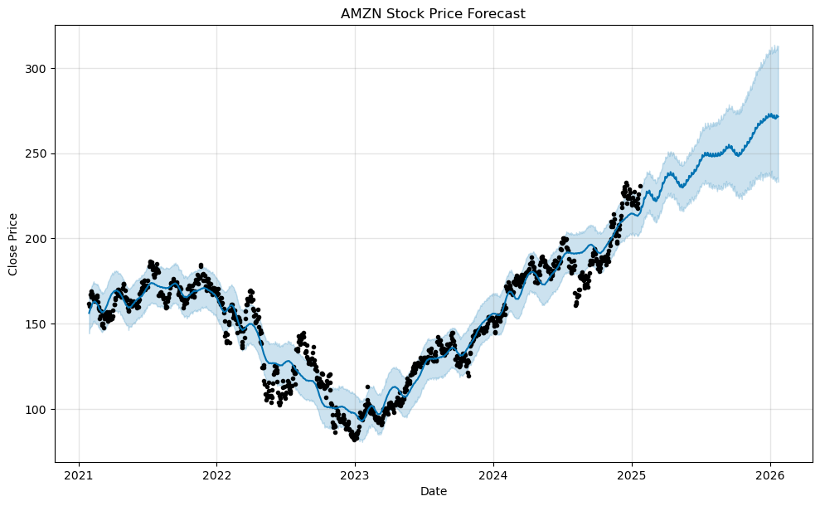
3. Prediction Analysis (1/5)

Slide 18
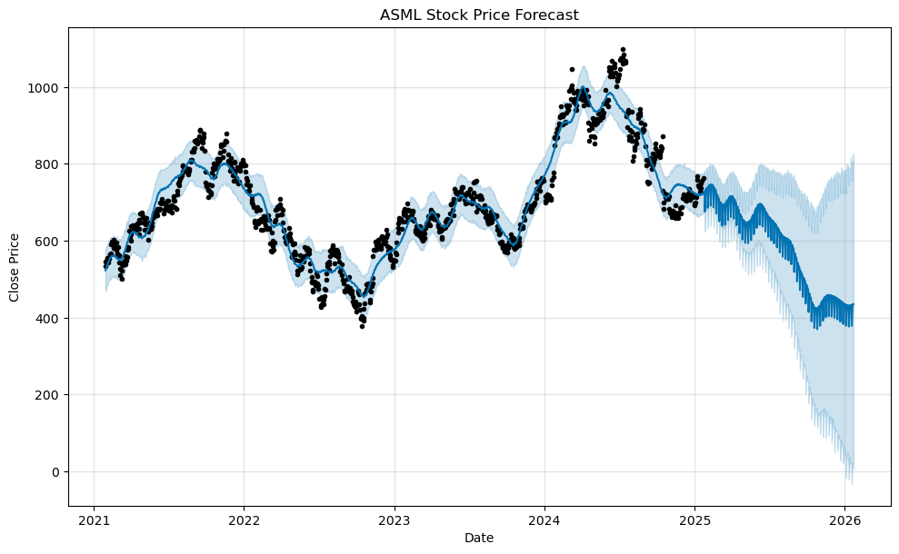
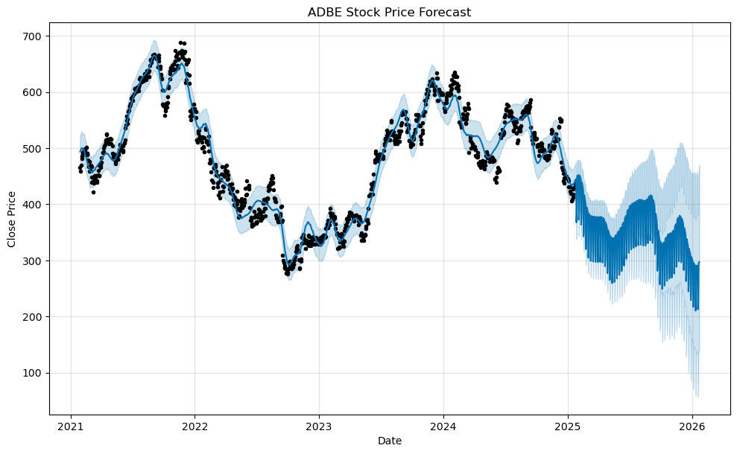
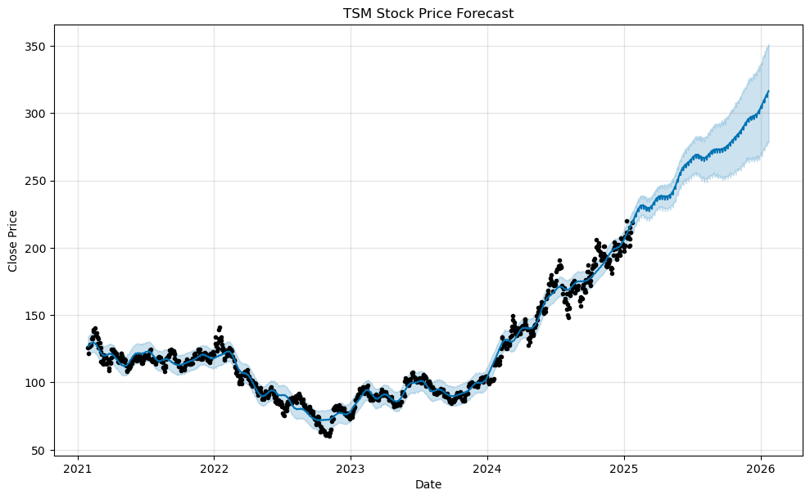
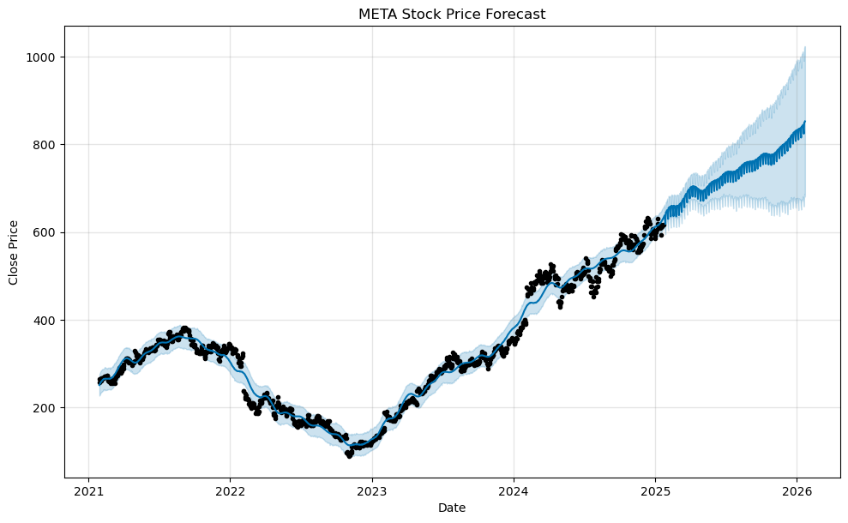
3. Prediction Analysis (2/5)

Slide 19
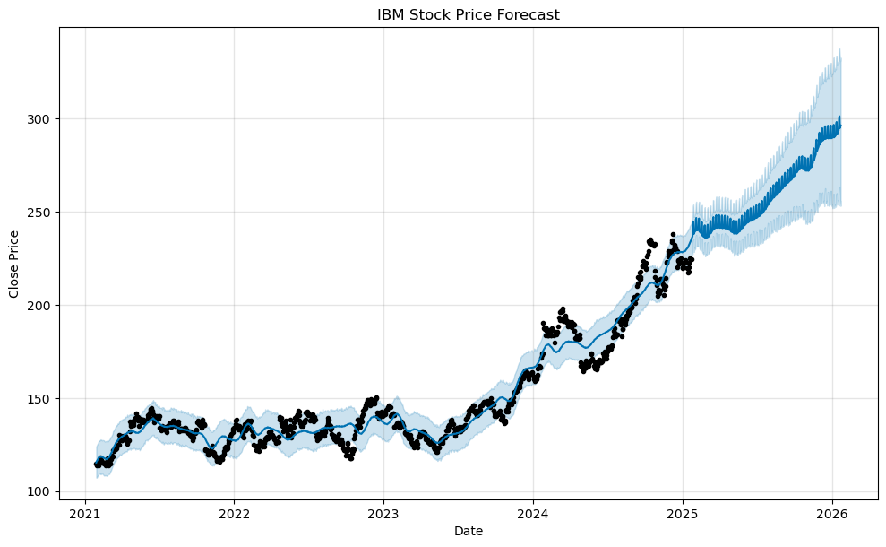
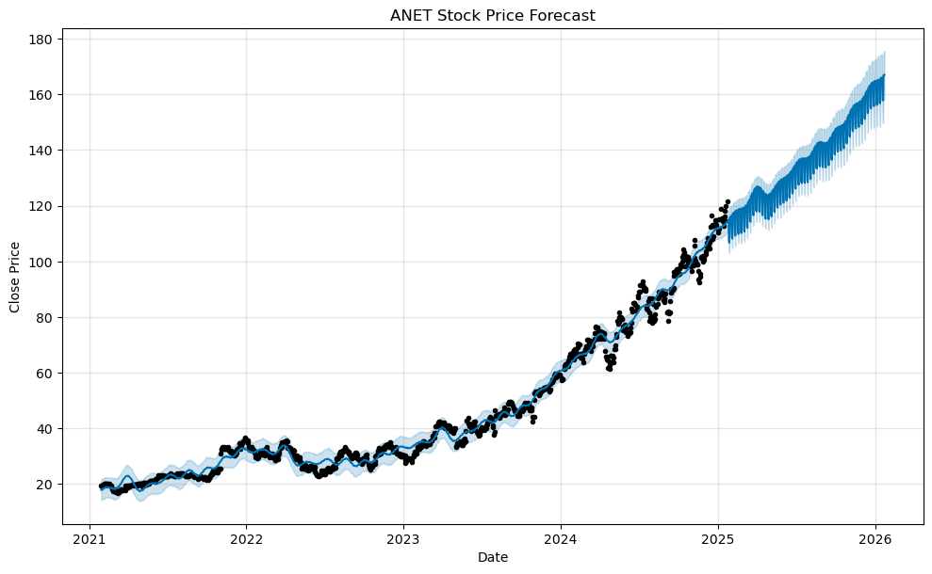
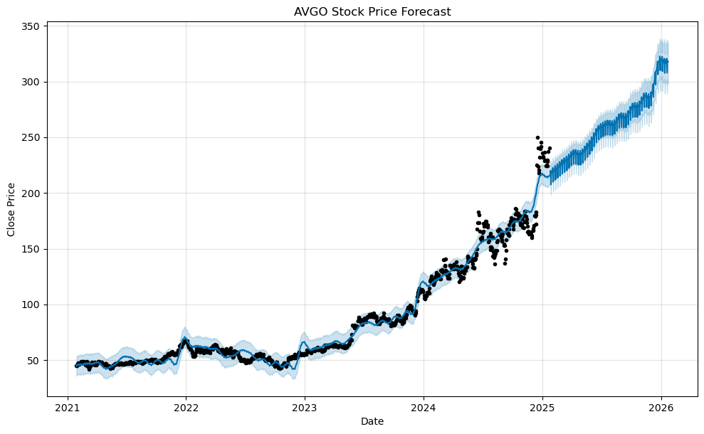
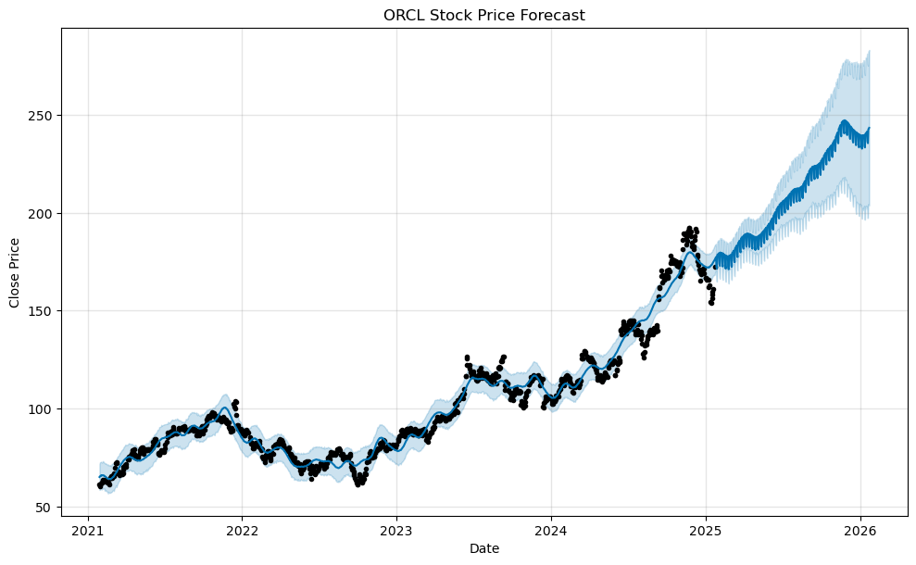
3. Prediction Analysis (3/5)

Slide 20
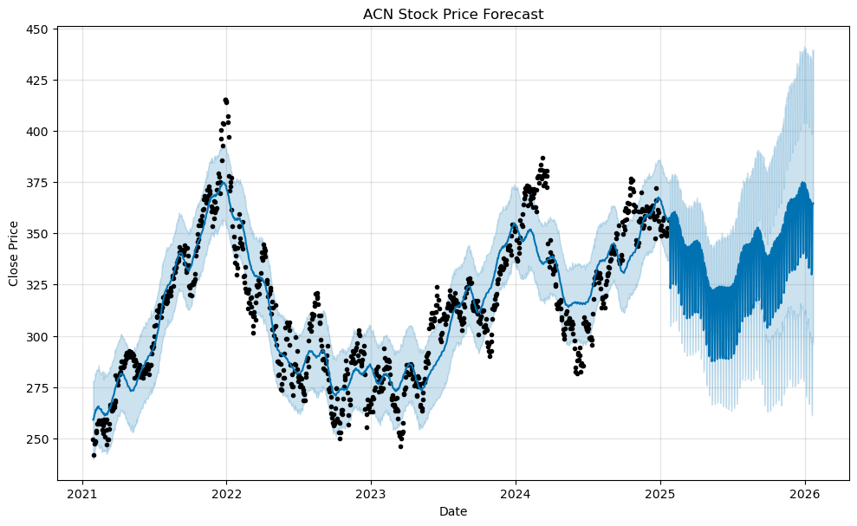
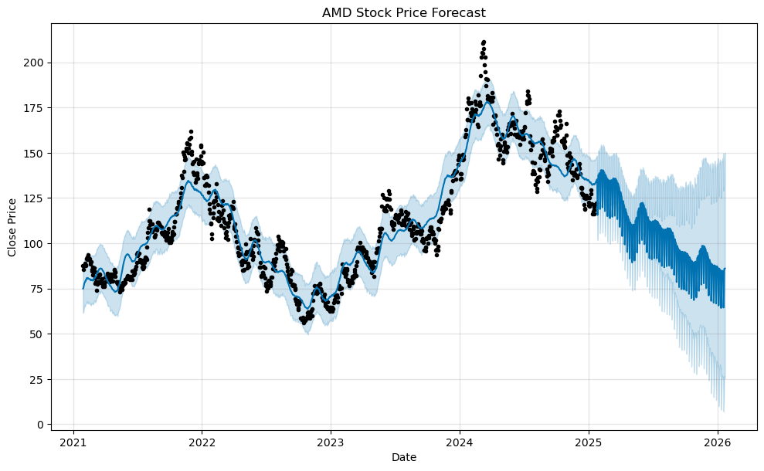
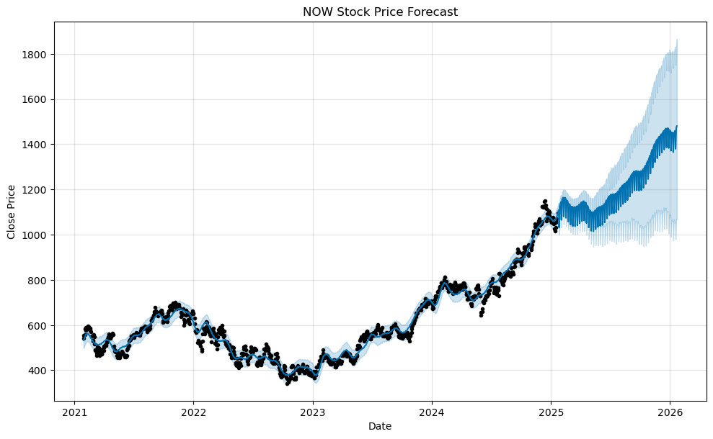
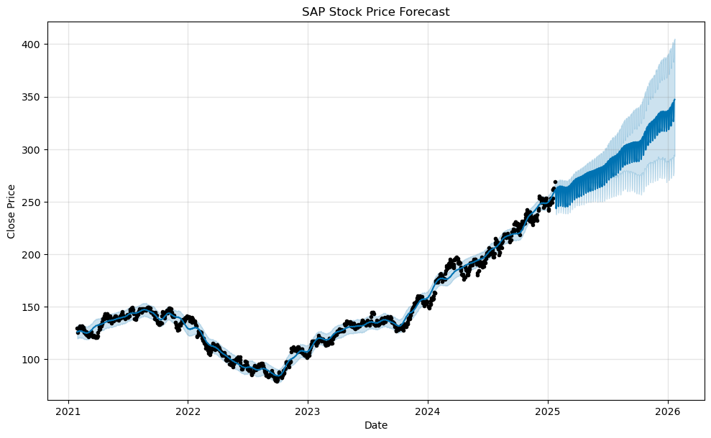
3. Prediction Analysis (4/5)

Slide 21
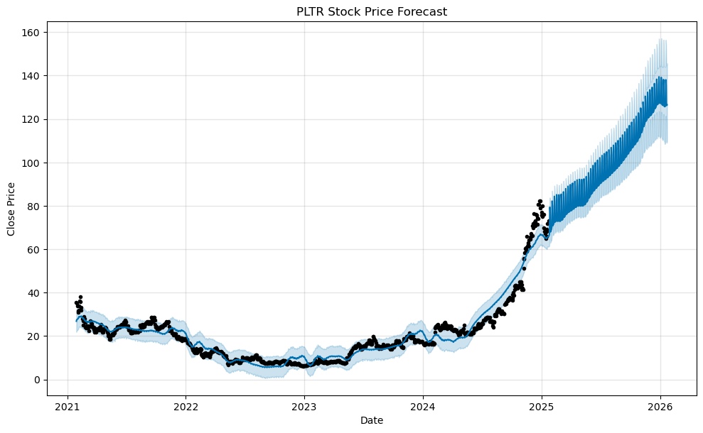
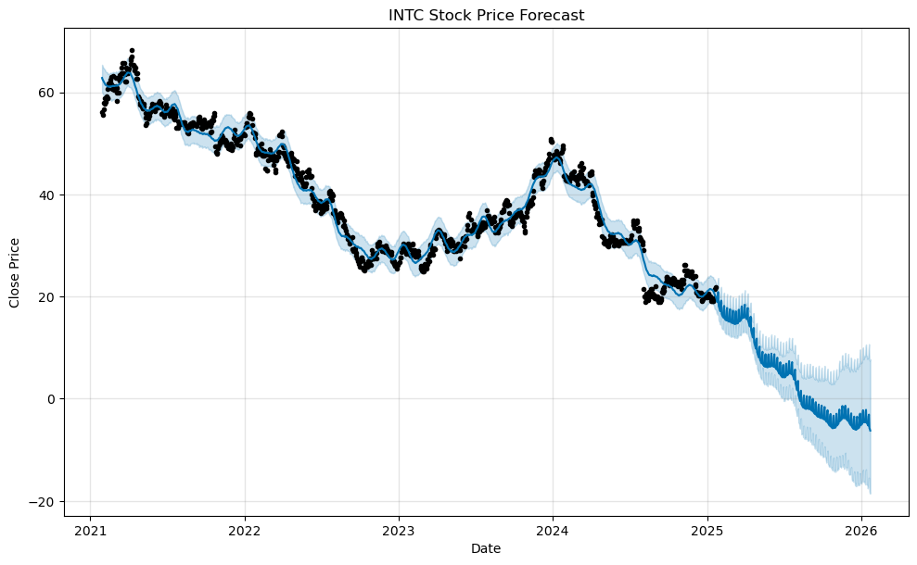
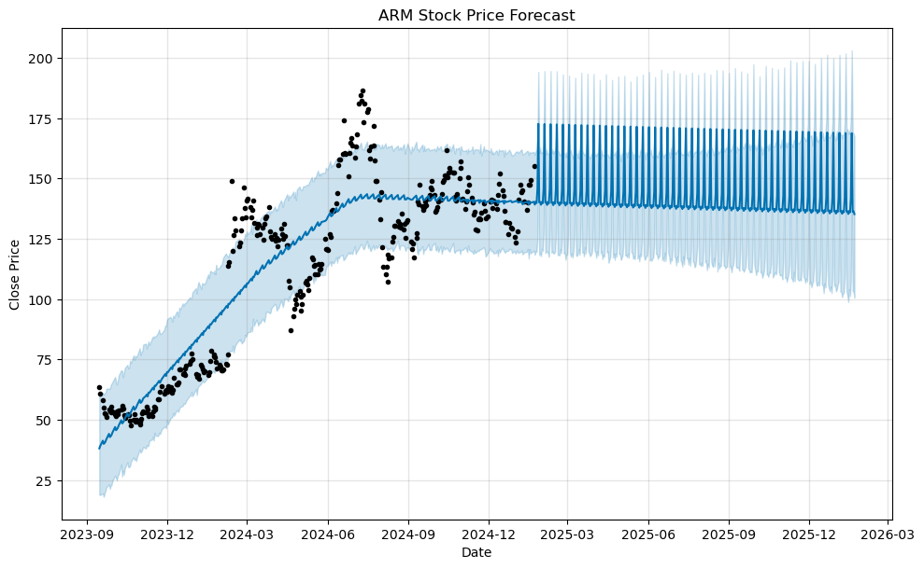
3. Prediction Analysis (5/5)

Slide 22
4. 52 Weeks and 12 Weeks Performance
 | 52 Weeks Performance | 12 Weeks Performance
ACN | -2.06 | -1.21
ADBE | -28.65 | -9.79
AMD | -29.82 | -21.73
AMZN | 48.52 | 22.83
ANET | 84.43 | 23.33
ARM | 97.51 | 7.97
ASML | 0.68 | 7.21
AVGO | 98.41 | 38.91
GOOGL | 35.30 | 19.83
IBM | 30.78 | 4.47
INTC | -54.79 | -4.01
META | 60.77 | 7.54
MSFT | 7.48 | 0.08
NOW | 46.42 | 15.35
NVDA | 136.73 | -0.50
ORCL | 57.35 | -0.55
PLTR | 335.46 | 62.88
ACN | -2.06 | -1.21
ADBE | -28.65 | -9.79

Slide 23

Recommendations
Timeframe, Diversification and Risk Assessment

Slide 24
Recommendations
Short-Term vs. Long-Term:
Short-term investment recommendations based on current trends.
Long-term investment recommendations considering outlook.
Diversification:
Suggested mix of NVIDIA, Microsoft, Alphabet, Amazon, and Meta Platforms stocks to spread risk.
Risk Assessment:
Evaluation of stability and potential returns for each stock.

Slide 25
Conclusion
Summary, Actionable Insights and Future Outlook

Slide 26
Summary & takeaways
Summary:
Recap
Actionable Insights:
Clear investment recommendations for the client.
Future Outlook:
Discussion of potential future performance based on current trends and market conditions.

Slide 27

Thank you
Austin McCormick
Devin Carter
Mehdi Afiatpour

